Slide 1


.
St. Thomas’ College of Engineering & Technology
Crime data analysis using
data mining
By
Rohan Bhowmick 12200117030
Ishika Chakrabarti 12200117045
Anwesha Chakraborty 12200118011
Group 6 {
Under the esteemed guidance of
Prof. Subhankar Mallick
Department of Computer Science & Engineering

Slide 2

Contents
INTRODUCTION
THHEORY & DISCUSSION
METHODOLOGY
IMPLEMENTATION
FUTURE WORK
CONCLUSION
REFERENCES

Slide 3

INTRODUCTION
CRIME DATA ANALYSIS
Crime analysis and prevention is a systematic approach for identifying and analysing patterns and trends in crime. Our system can predict regions which have high probability for crime occurrence and can visualize crime prone areas. With the increasing advent of computerized systems, crime data analysts can help the Law enforcement officers to speed up the process of solving crimes.

Slide 4
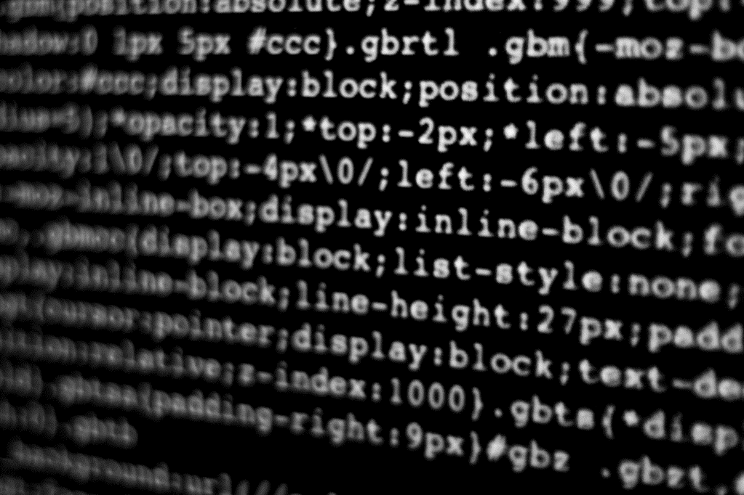
objectives
The objective of this project is:
To identify the nature of crime and the crime prevention process to extracting named entities from narrative reports.
To explore and choose among the various data mining software that support clustering and association rule mining technique to experiment with crime records.
To build and train as well as test the performance of the model.
To interpret and analyse the results of the model that how strong is the model to extract crime data patterns.
To compare the clustering and association rules data mining techniques and select the one which performs the best results.
To compare our proposed model with some recent working model.
Finally, to forward recommendations based on the findings of the study.

Slide 5
THEORY & DISCUSSION
Data Mining, what is it?
Generally, data mining (sometimes called data or knowledge discovery) is the process of analyzing data from different perspectives and summarizing it into useful information, that can be used to increase revenue, cuts costs, or both.
Data mining software is one of a number of analytical tools for analyzing data.

Slide 6

Application and Trends
Financial Data Analysis
Retail Industry
Telecommunication Industry
Biological Data Analysis
Other Scientific Applications
Intrusion Detection

Slide 7

Crime data analysis using data mining
LOOKING AHEAD

Slide 8
Why Analyse Crime?
Analyse crime to inform law enforcers about general and specific crime trends, patterns, and series in an ongoing, timely manner.
Analyse crime to take advantage abundance of information existing in law enforcement agencies the criminal justice system, and the public domain.
Analyse crime to maximize the use of limited law enforcement resources.

Slide 9
Data Mining and Crime Pattern
We will look at how to convert crime information into a data-mining problem. In this case it can help the analysts to identify crimes faster and help to make faster decisions. We have seen that in crime terminology a cluster is a group of crimes in a geographical region or a hot spot of crime.
Challenges we are facing are:
Increase in crime information that has to be stored annualized.
Analysis of data is difficult since data is incomplete and inconsistent.
Accuracy of the program depends on accuracy of the training set.
Limitation in getting crime data records from Law Enforcement department

Slide 10
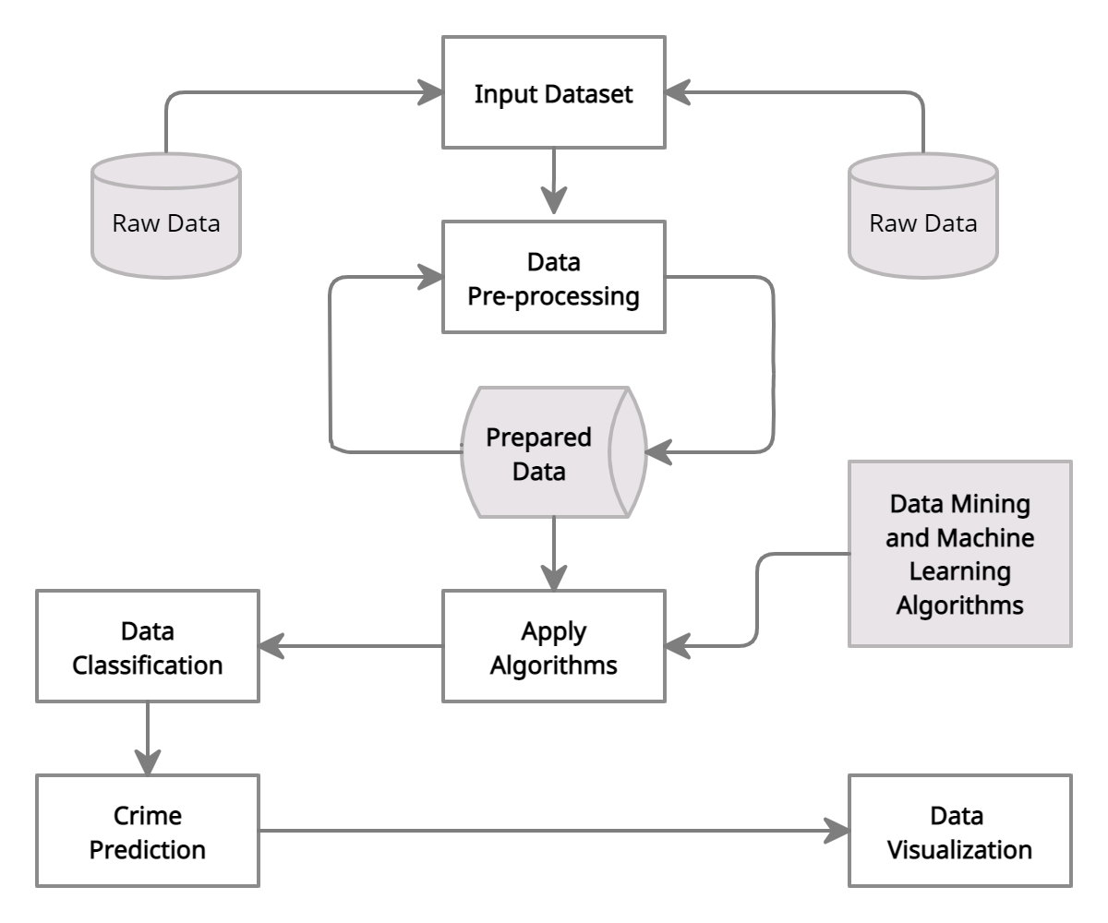



Steps in doing Crime Analysis
Figure 1: Steps in doing Crime Analysis

Slide 11

Methodology
Data Collection
Collecting data from various sources like news sites, blogs, social media, RSS feeds etc.
But the data we got is ‘VERY UNSTRUCTURED’!, and how do we store it?!
The advantage of NoSQL database over SQL database is that it allows insertion of data without a predefined schema.
Object-oriented programming- hence is easy to use and flexible.
Unlike SQL database it not need to know what we are storing in advance, specify its size etc.

Slide 12

Methodology
Classification
Naïve Bayes- a supervised learning method as well as a statistical method
The algorithm classifies a news article into a crime type to which it fits the best Eg. "What is the probability that a crime document D belongs to a given class C?“
Using Naive Bayes algorithm we create a model by training crime data related to vandalism, murder, robbery, burglary, sex abuse, gang rape, arson, armed robbery,
highway robbery, snatching etc.
Test results shows that Naive Bayes shows more than 90% accuracy!!

Slide 13
Methodology
Pattern Identification
Apriori algorithm- used to determine association rules which highlight general trends
The result of this phase is the crime pattern for a particular place.
After getting a general crime pattern for a place, when a new case arrives and if it follows the same crime pattern then we can say that the area has a chance for crime occurrence.
Information regarding patterns helps police officials to facilitate resources in an effective manner.

Slide 14

Methodology
Prediction
Decision tree- It is simple to understand and interpret!
Its robust nature and also it works well with large datasets.
Visualization
A heat map which indicates level of activity, usually darker colors to indicate low activity and brighter colors to indicate high activity.

Slide 15
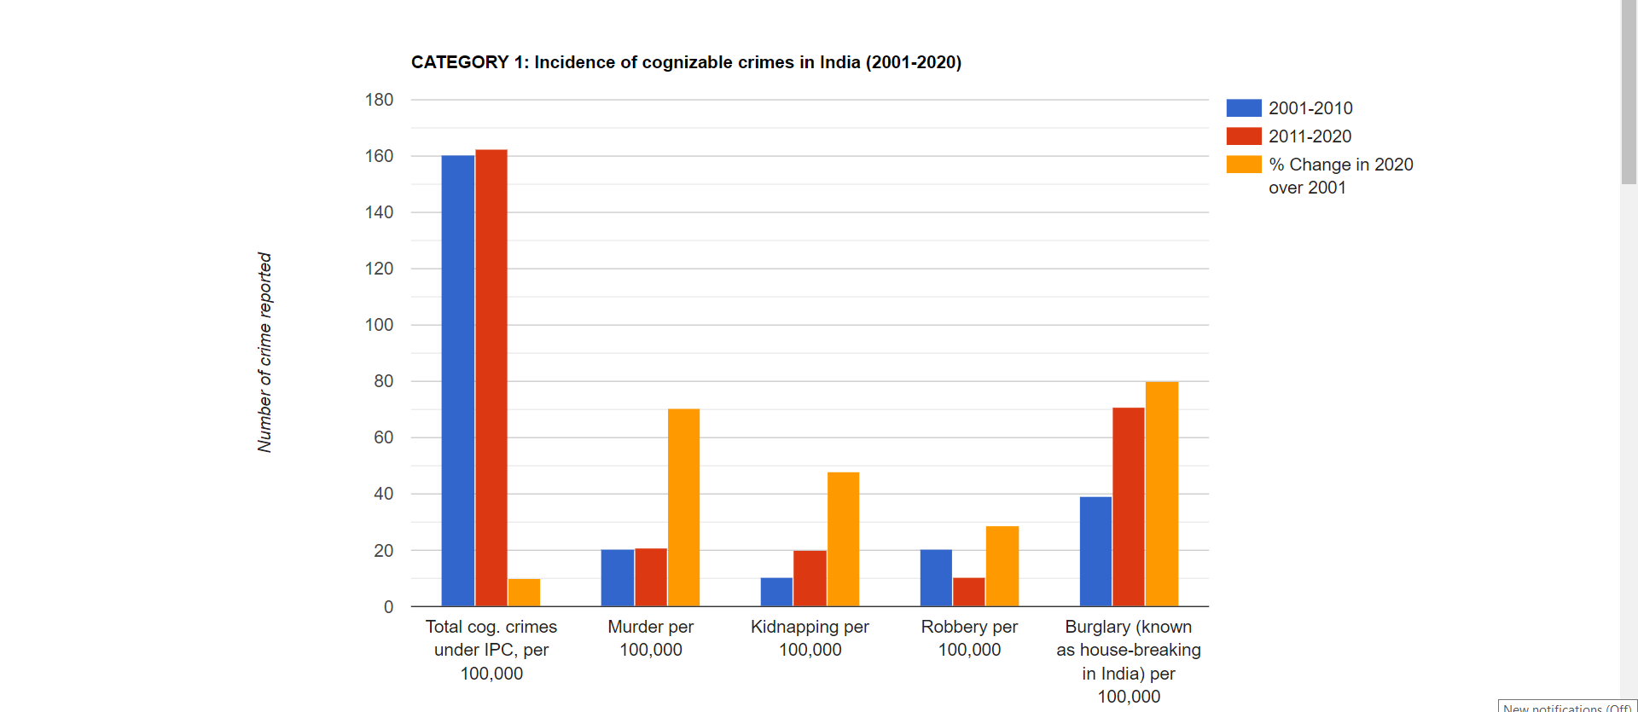
Implementation using Data Visualizing Technique

Slide 16
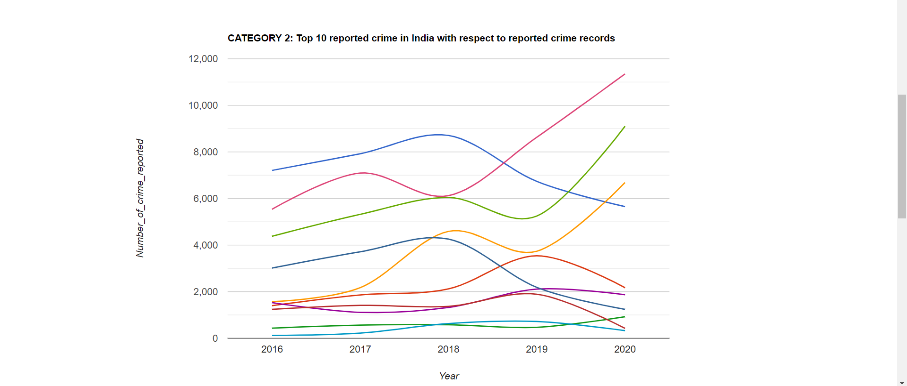
Most Reported crime

Slide 17
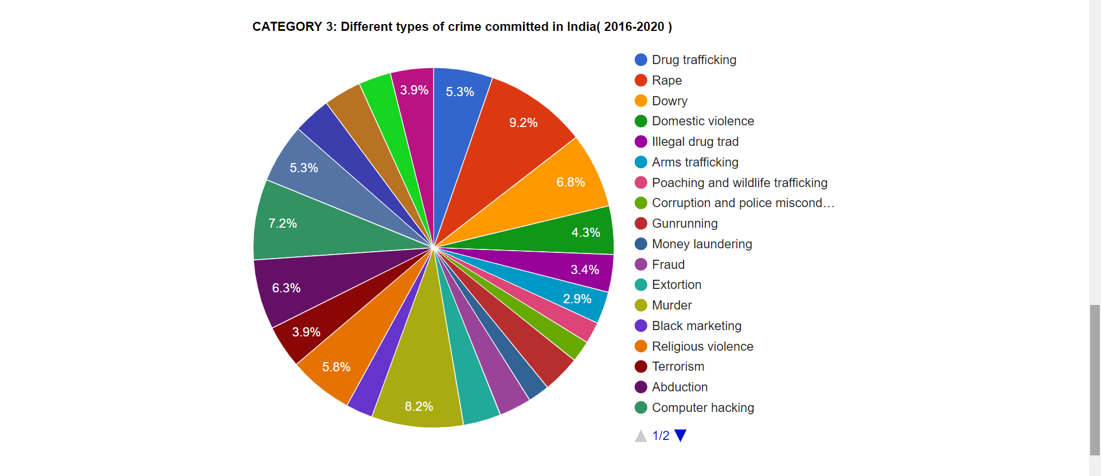
Different Types of Crime with crime rate

Slide 18
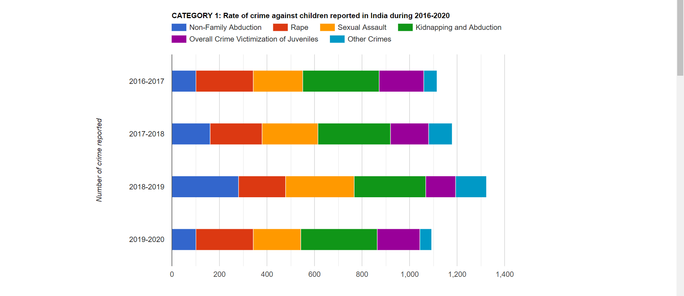
Crimes Against Child

Slide 19
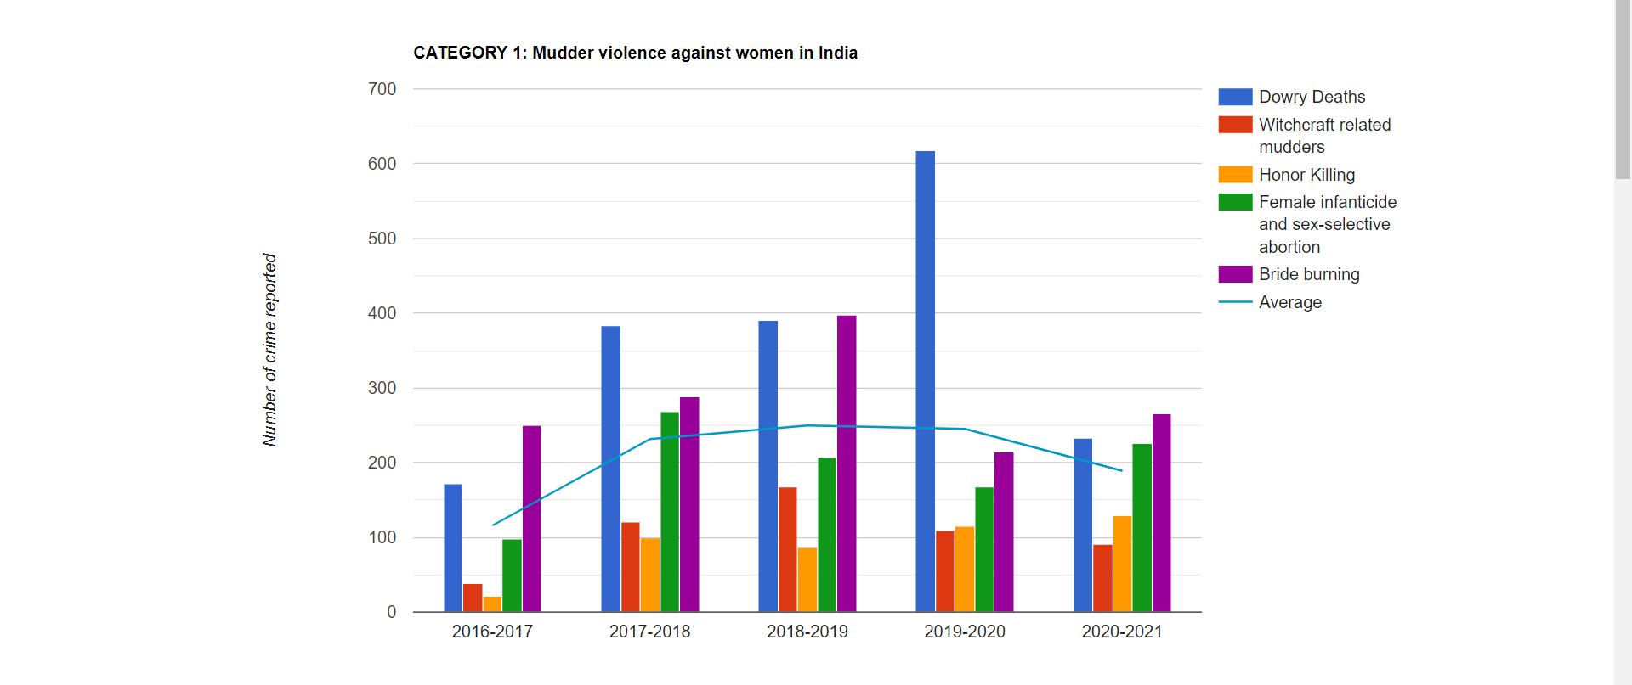
Crime Against Women

Slide 20
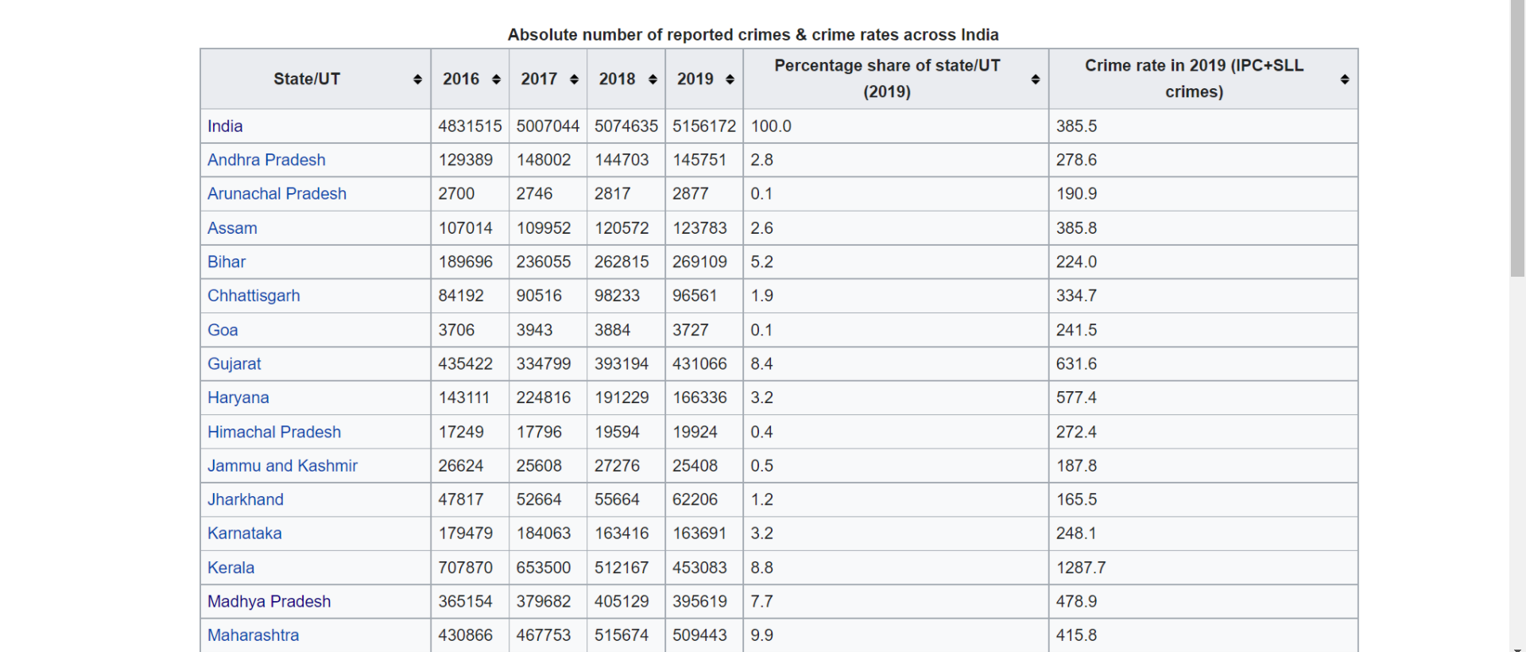
Distribution of Crime over the Year

Slide 21
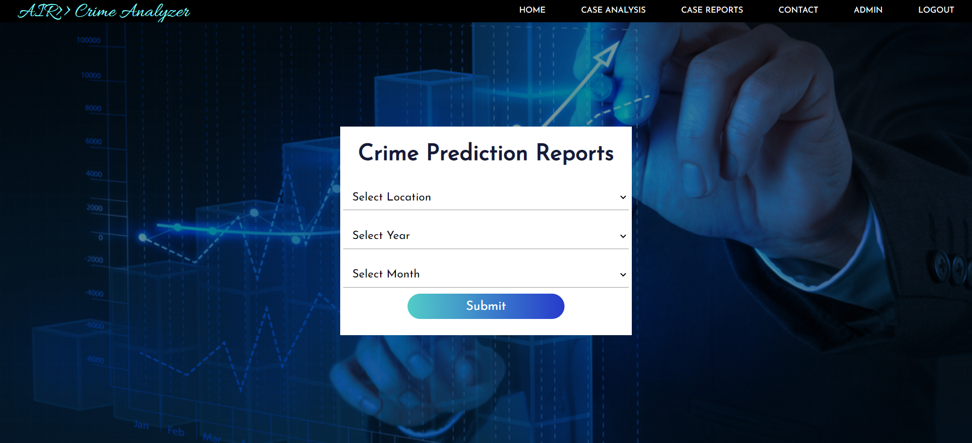
Crime Prediction

Slide 22
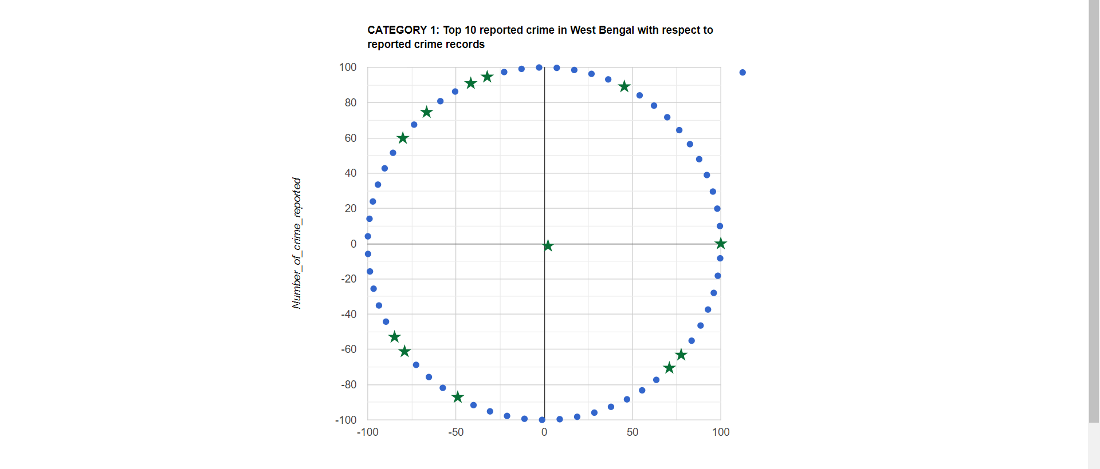
Crime Prediction Results

Slide 23

Future Work
Criminal Profiling
Helps the crime investigators to record the characteristics of criminals.
The main goal of doing criminal profiling is that:
To provide crime investigators with a social and psychological assessment of the offender
To evaluate belongings found in the possession of the offender

Slide 24

CONCLUSION
An acceptable model for data mining which comes up with excellent results of analysing crime data set; it requires huge historical data that can be used for creating and testing the model. More than 150500 crime records that were used in this work can give estimation and lead to an acceptable model. VS Code and Excel software were used to pre-process and analyse the collected crime and criminal data.

Slide 25

REFERENCES
[1] Malathi. A and Dr. S. Santhosh Baboo. Article:an enhanced algorithm to predict a future crime using data mining. International Journal of Computer Applications, 21(1):1–6, May 2011. Published by Foundation of Computer Science.
[2] Eibe Frank and Remco R. Bouckaert. Naive bayes for text classification with unbalanced classes. In Proceedings of the 10th European Conference on Principle and Practice of Knowledge Discovery in Databases, PKDD’06, pages 503–510, Berlin, Heidelberg, 2006. Springer-Verlag.
[3] Ralf Hartmut Güting. Graphdb: Modeling and querying graphs in databases. In Proceedings of the 20th International Conference on Very Large Data Bases, VLDB ’94, pages 297–308, San Francisco, CA, USA, 1994. Morgan Kaufmann Publishers Inc

Slide 26

References
[4] Lior Rokach and Oded Maimon. Decision trees. In Oded Maimon and Lior Rokach, editors, The Data Mining and Knowledge Discovery Handbook, pages 165–192. Springer, 2005.
[5] Tong Wang, Cynthia Rudin, Daniel Wagner, and Rich Sevieri. Detecting patterns of crime with series finder. In Proceedings of the European Conference on Machine Learning and Principles and Practice of Knowledge Discovery in Databases (ECMLPKDD 2013), 2013.
[6] R. Sanjana, H. S. S, and S. Sruthi, ‘Big Data Approach for Crime Classification and Visualization Using Crime Dataset’, Int. J. Innov. Res. Sci. Eng. Technol., vol. 7, no. 2, pp. 25–29, 2018.
[7] A. Jain and V. Bhatnagar, ‘Crime Data Analysis Using Pig with Hadoop’, Procedia Comput. Sci., vol. 78, no. December 2015, pp. 571–578, 2016.

Slide 27
THANK YOU

